Slide 1





Ontologies for Everyone
Peter Murray-Rust
University of Cambridge
OntoCommons , 2021-11-03
Talk will show a range of ontologies, demos, software, and suggestions for discussion.
Aimed at non-specialists
NOTE: revised, after listening to yesterday’s session . Some new ideas
pm286@cam.ac.uk
peter@contentmine.org
Images from ContentMine CC BY and Wikimedia CC BY-SA

Slide 2
Emphasis
Multilingual, Terminology
Wikidata / Wikipedia
Dynamic
Unconstrained, lightweight
Fun and accessible. Demos
Domains:
Chemistry
Plants
Places, diseases, organizations…
(No OWL, No FOL, No Protégé)
PURPOSE: To mine the whole scientific literature automatically for plant chemistry

Slide 3
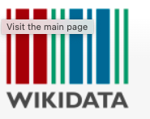

Slide 4
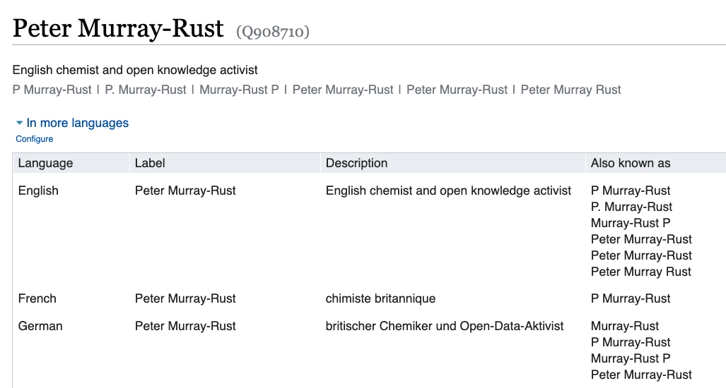

Slide 5
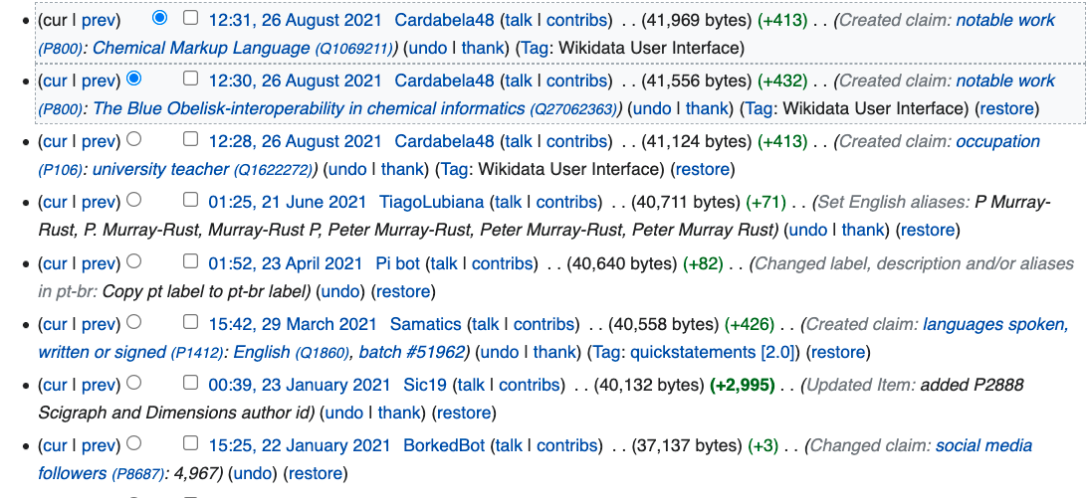
Wikidata is regularly updated, by volunteers

Slide 6
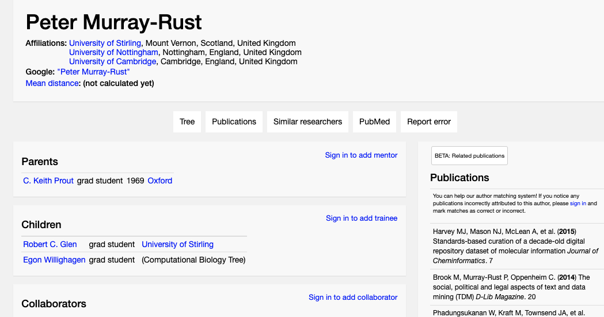
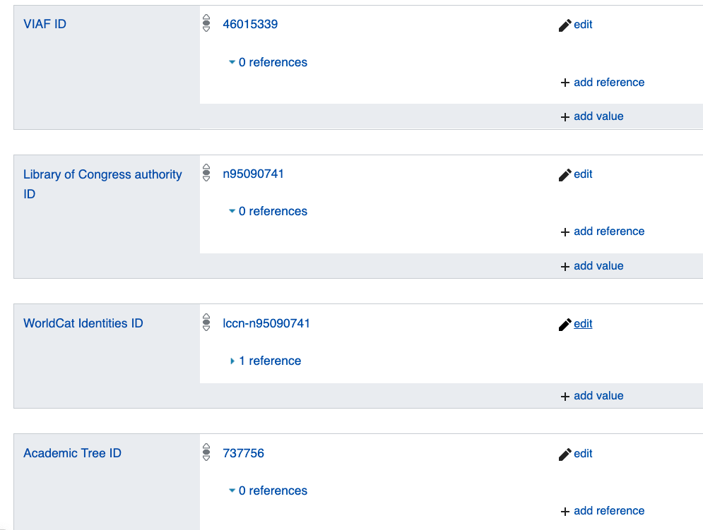
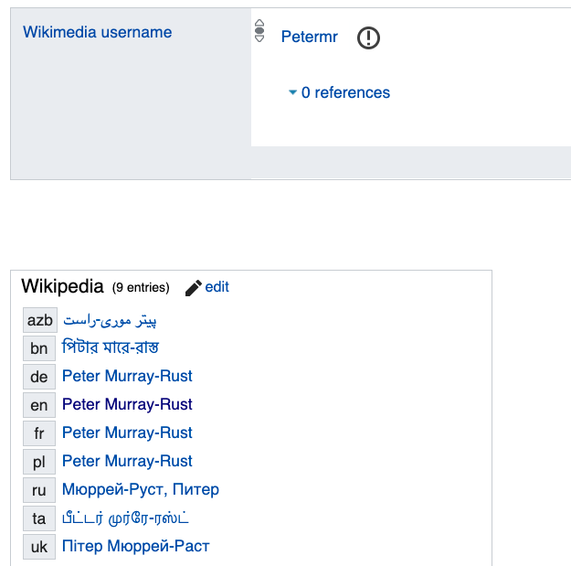

Slide 7
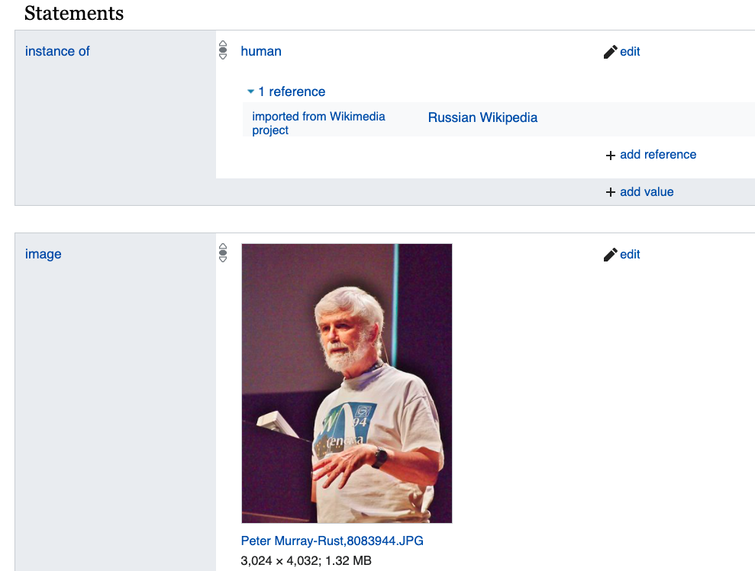
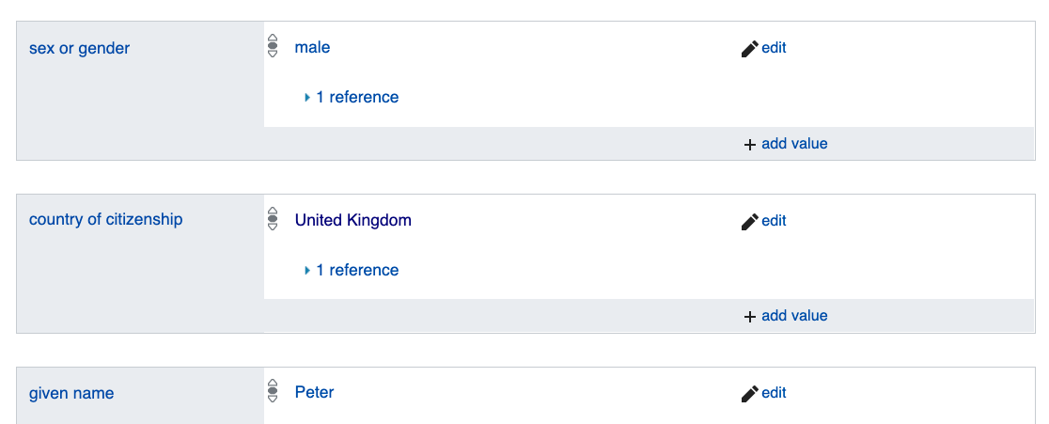

Slide 9
Emphasis
Multilingual, Terminology
Wikidata / Wikipedia
Dynamic
Unconstrained
Fun and accessible. Demos
Domains:
Chemistry
Plants
Places, diseases, organizations…
(No OWL, No FOL, No Protege)
PURPOSE: To mine the whole scientific literature automatically for plant chemistry

Slide 10
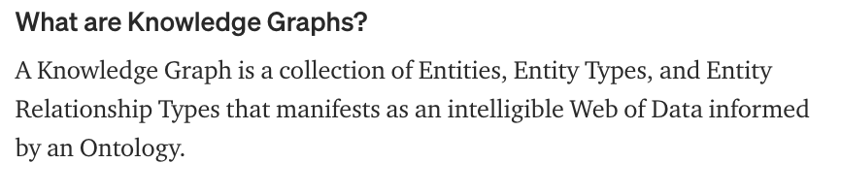

Continuum of:
Terminology, dictionaries, knowledge graphs, ontologies, metadata, data

Slide 11
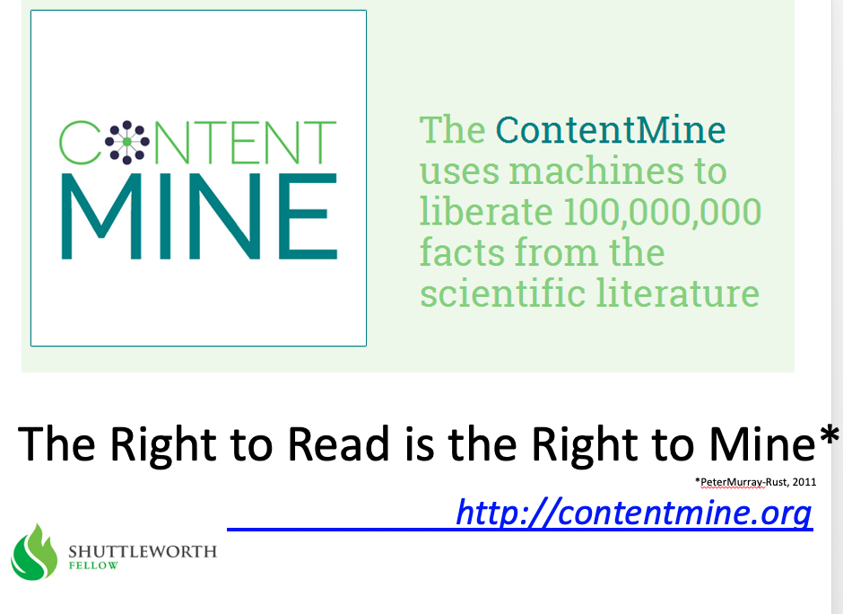
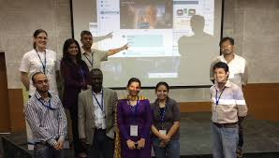
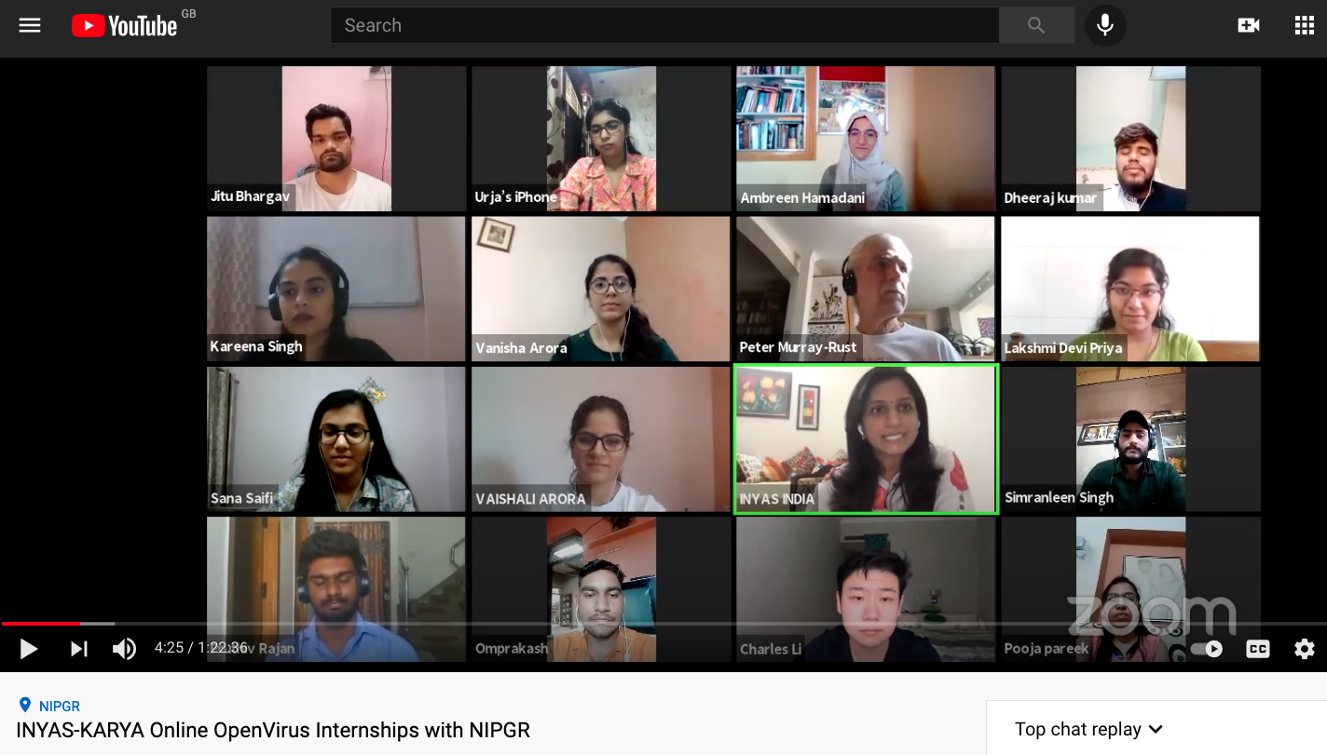
2013
TIGR2ESS 2019 Delhi Food Security FEB 2019
Gita Yadav + colleagues
Delhi 2014
NIPGR: Developed Virtually over 6 weeks!
OpenVirus
Priya and Kareena interns
JUNE 2020
INYAS – KARYA-DBT
CEVOpen 2021
https://www.youtube.com/watch?v=XiTngk-POm8&ab_channel=INYASYouTube
Aug 2020
2020-06-01

Slide 12
What are ontologies for?
Identification (unique ID)
Annotation
Searching
Constraints
Computability
Translation: languages, data and ideas
Linking
Combinability
Memex (harvests usage)
Business logic
Political Control
What is yours for?

Slide 13
Thoughts and contrasts
what is your ontology for?*
who is your ontology for?*
Some contrasts (all are valuable)
constrained versus unconstrained
consistent versus inconsistent ontologies
Top-down or bottom-up
static vs dynamic :
time; content evolution
breadth; new concepts
automatic vs human
control vs. freedom
* answers in the chat?

Slide 14
WikidataCon 2021 (Problems! Lydia Pintscher)

Slide 15
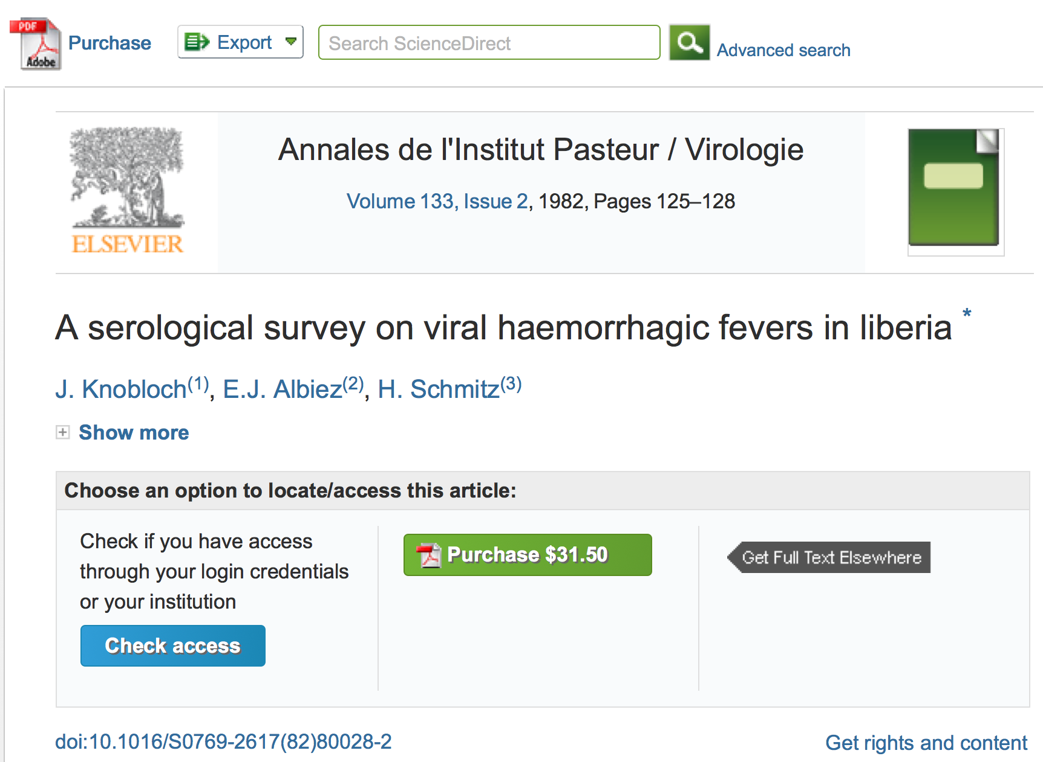
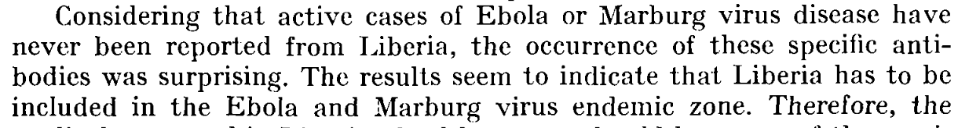

Slide 16
A System Failure of Scholarly Publishing
http://www.nytimes.com/2015/04/08/opinion/yes-we-were-warned-about-ebola.html
We were stunned recently … an article by European researchers in Annals of Virology [1982]: “Liberia has to be included in the Ebola virus endemic zone. … medical personnel in Liberian health centers […] may come across active cases,”
Bernice Dahn (chief medical officer of Liberia’s Ministry of Health)
Vera Mussah (director of county health services)
Cameron Nutt (Ebola response adviser to Partners in Health)
Can we use machines to scan the whole literature For VIRAL EPIDEMICS?

Slide 17
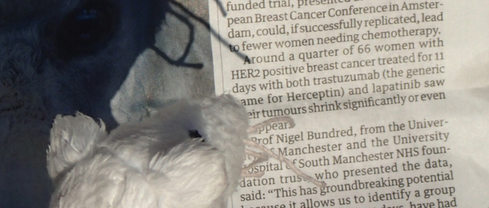
What do these mean?
Receptor
Drug
Drug
Computable Reusable Object Narrative

Slide 18
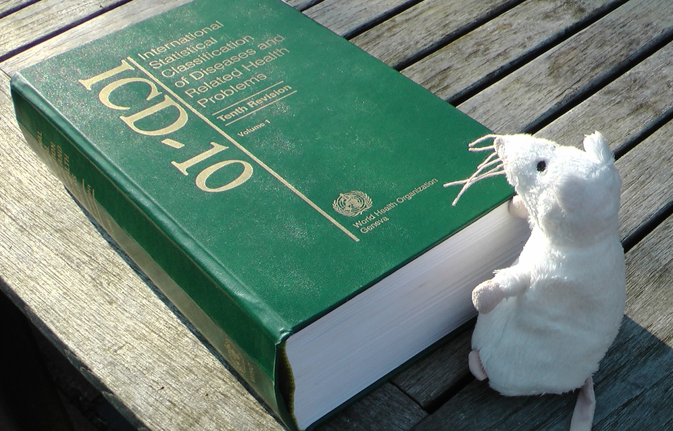
WHO International Statistical Classification of Disease
Purposes:
ICD-10 for national reporting every disease/condition
ICD-10-CM diagnosis and insurance (USA)

Slide 19
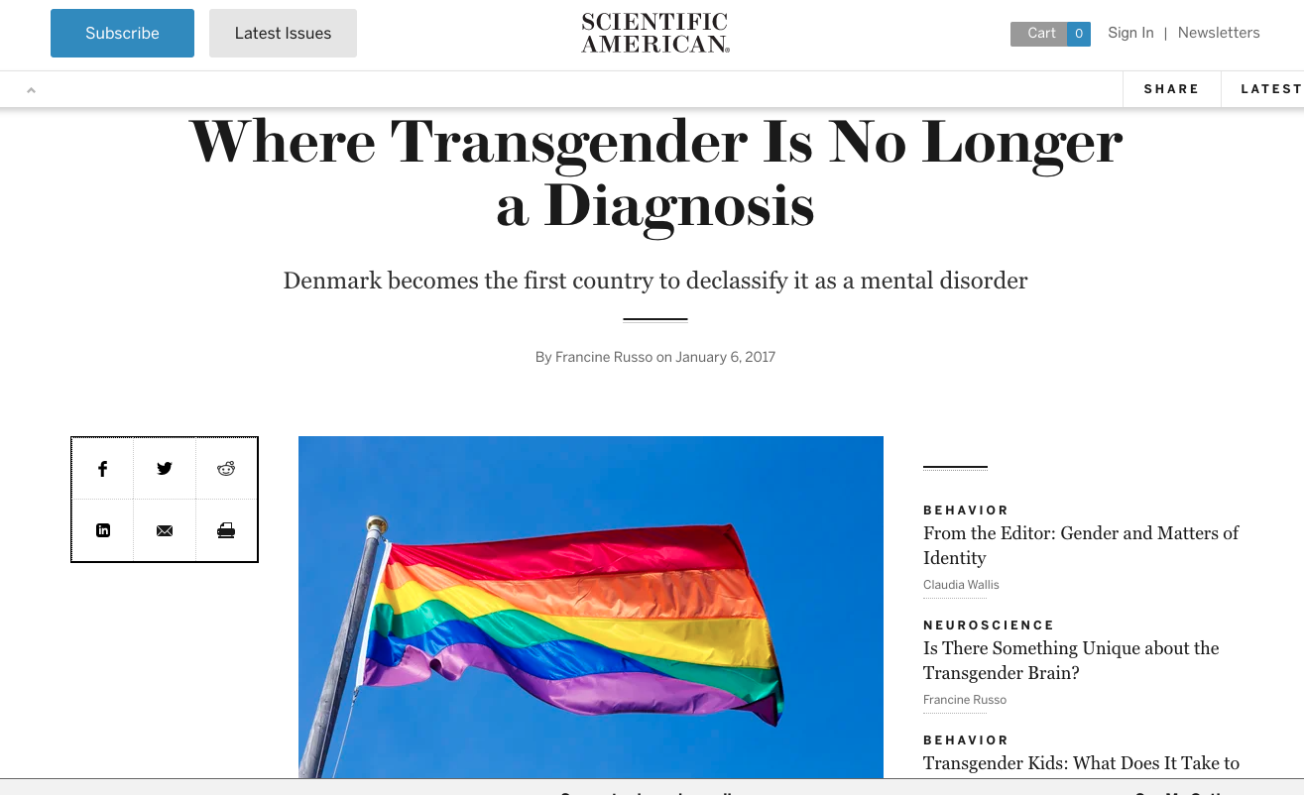
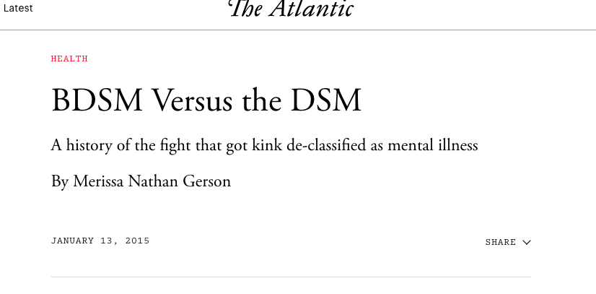
Ontologies constrain/enhance the way we think and talk
Diagnostic and Statistical Manual of Mental Disorders

Slide 20
Text Mining

Slide 21
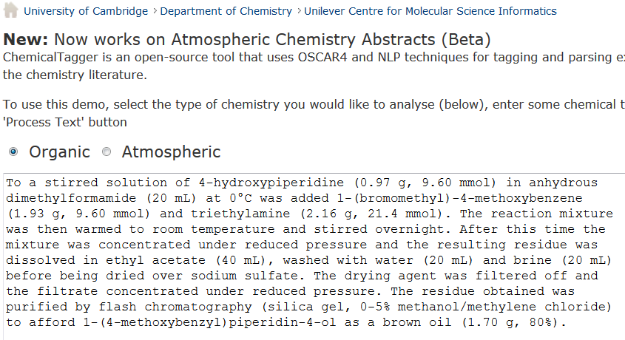
http://chemicaltagger.ch.cam.ac.uk/
Typical
Typical chemical synthesis
This contains several small annotating and parsing ontologies

Slide 22
http://chemicaltagger.ch.cam.ac.uk/
Typical
Typical chemical synthesis
This contains several small annotating and parsing ontologies

Slide 23
Materials discourse
SCIENTIFIC REPORTS | 4 : 5694 | DOI: 10.1038/srep05694
The syntheses of NiO and LiNi 0.4Mn 0.4Co 0.18Ti 0.02O 2 (NMC) were performed according to previously developed protocols 56. In short, NiO was synthesized using a solvothermal method aided with an alcohol pseudo-supercritical drying technique. NMC was synthesized using a co-precipitation method followed by high-temperature annealing with LiOH. 2032 Coin cells were fabricated using composites of NiO or NMC as working electrodes and lithium metal foils as counter electrodes. The NiO working electrodes were composed of 80 wt.% active material, 10 wt.% polyvinylidene fluoride (Kureha Chemical Ind. Co. Ltd) and 10 wt.% acetylene carbon black (Denka, 50% compressed) and loadings were typically 12 mg/cm 2 of active material. To make the electrodes, these solids were mixed into N-methyl-2-pyrrolidinone and the resulting slurry cast onto copper current collectors and dried. NMC working electrodes were prepared similarly and contained 84 wt.% active material, 8 wt.% polyvinylidene fluoride, 4 wt.% acetylene carbon black and 4 wt.% SFG-6 synthetic graphite on carbon-coated aluminum current collectors, with typical active material loadings of 67 mg/cm 2. The coin cells were assembled in a helium-filled glove box using Celgard 2400 separators and 1 M LiPF6 electrolyte in 1:2 w/w ethylene carbonate/dimethyl carbonate (Ferro Corporation). Battery testing was performed on a computer controlled VMP3 potentiostat/galvanostat (BioLogic). NiO and NMC electrodes were cycled at C/2 and C/20 rates, respectively. 1C was defined as fully discharging or charging an electrode in 1 h, corresponding to specific current densities of 718 mA/g and 280 mA/g for NiO and NMC materials, respectively.
Cut-n-paste into
http://chemicaltagger.ch.cam.ac.uk/
Written ca 2007 by Lezan Hawizy
Daniel Lowe wrote OPSIN (name to structure)

Slide 24
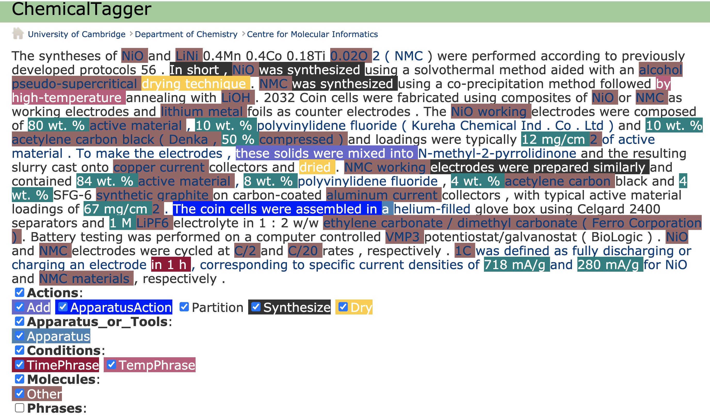
ChemicalTagger “out of the box” on Materials discourse
The unmarked fields need dictionaries!

Slide 25
Crystallography: CIF where much of this began

Slide 26
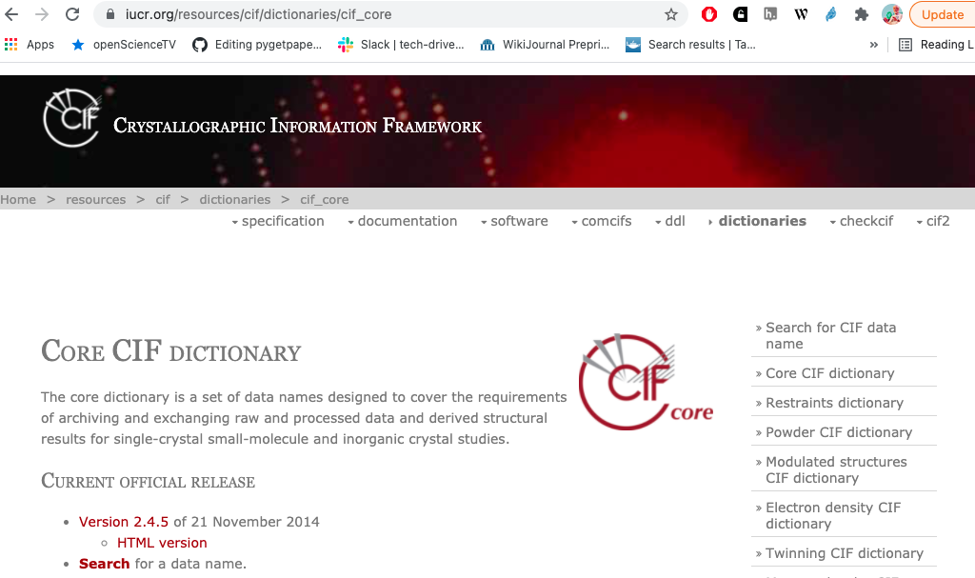
CIF: crystallographic ontology – a model beyond formats
In the late [1970s] the IUCr Commissions […] promoted the development of the Standard Crystallographic File Structure
“Framework” (model) , not “file”
[late 1980s] IUCr promoted the submission of data
in machine-readable form
30 years !
Hall SR, Allen FH, Brown ID (1991). "The Crystallographic Information File (CIF):
a new standard archive file for crystallography". Acta Crystallographica Section A. 47 (6):
655–685. doi:10.1107/S010876739101067X.

Slide 27
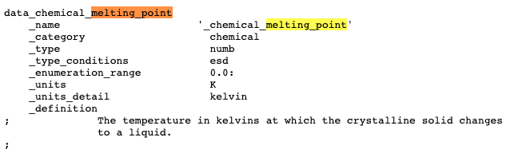
Typical CIF data entry
Container of Name-value pairs
Unique_id
Classification
Datatype
Error limits
Allowed range
Mandated units
CIF Supports:
Editing
Checking
Transformation
Human discourse
Data can be mixed with text (LaTeX)

Slide 28
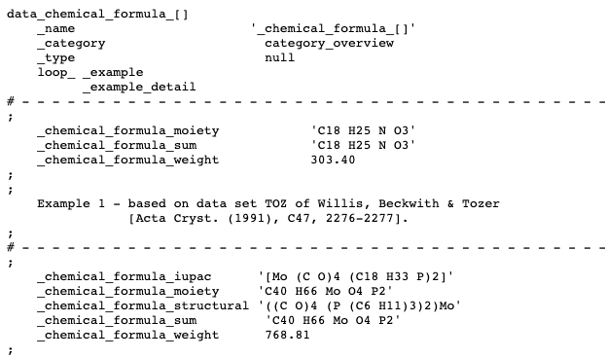

Slide 29
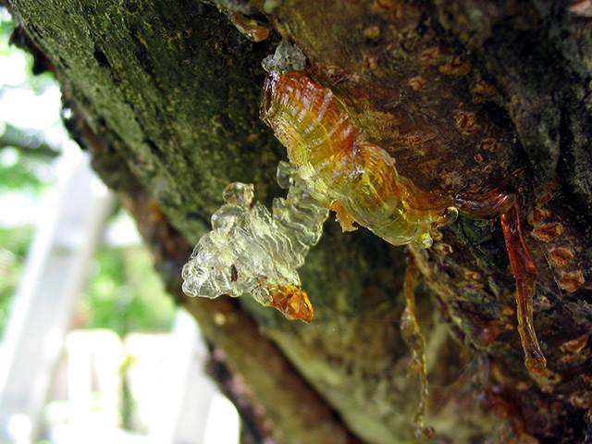
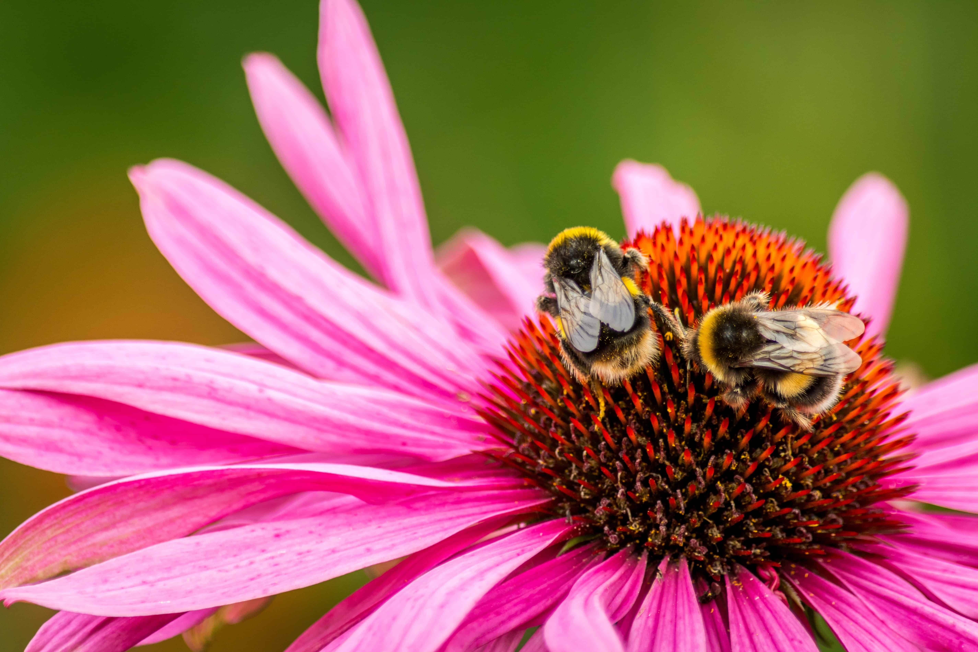


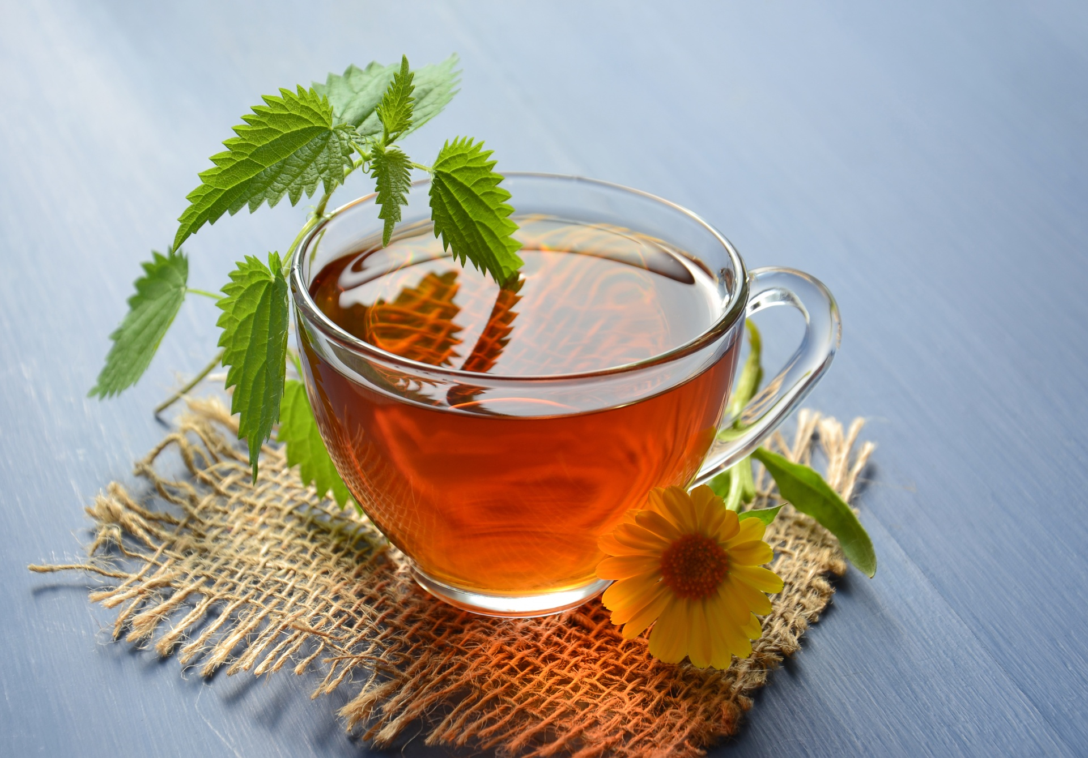
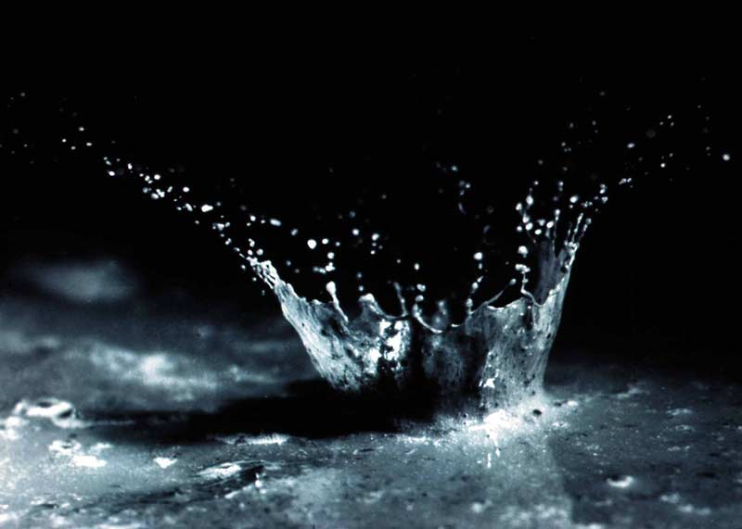
Why Plant Chemistry?
“Plants are better chemists than we are!“
Plants use chemicals to:
communicate
Defend and resist disease
Attract pollinators
…
And for literally everything else!
Aromatic!
TERPENES!
Mint पुदिना ಪುದಿನ
>20000 compounds
All have same starter molecule
Based on what enzymes acts on the starting molecules the final product is different
Notes:
This Photo by Unknown Author is licensed under CC BY-SA
This Photo by Unknown Author is licensed under CC BY-SA

Slide 30
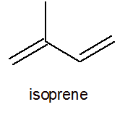
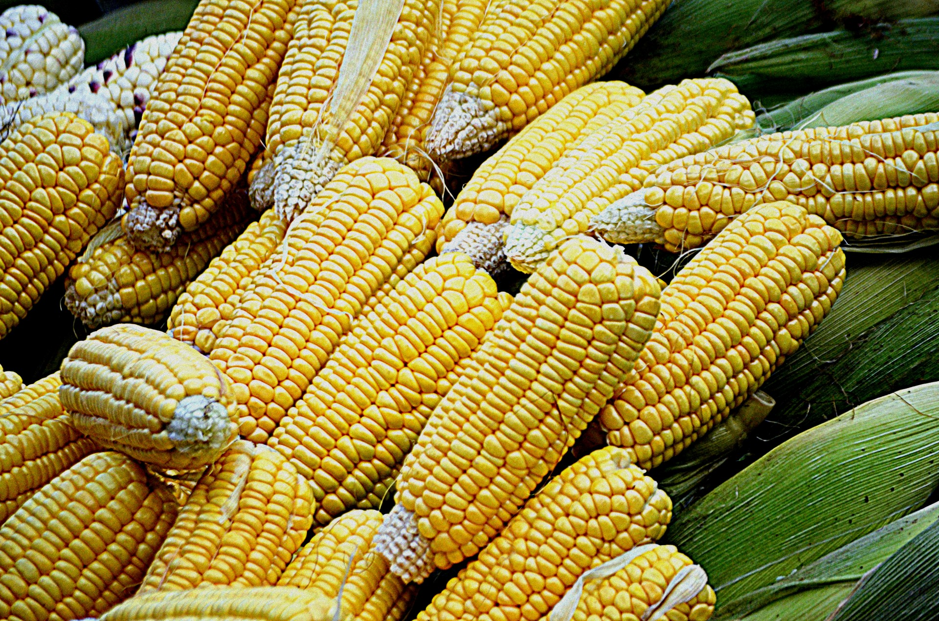
Why Plant Chemistry?
“Plants are better chemists than we are!“
Plants use chemicals to:
communicate
Defend and resist disease
Attract pollinators
…
And for literally everything else!
Aromatic!
TERPENES!
>20000 compounds
All have same starter molecule
Based on what enzymes acts on the starting molecules the final product is different
Enzymes
MINT
…
Notes:
This Photo by Unknown Author is licensed under CC BY-SA
This Photo by Unknown Author is licensed under CC BY-SA
This Photo by Unknown Author is licensed under CC BY-SA-NC

Slide 31
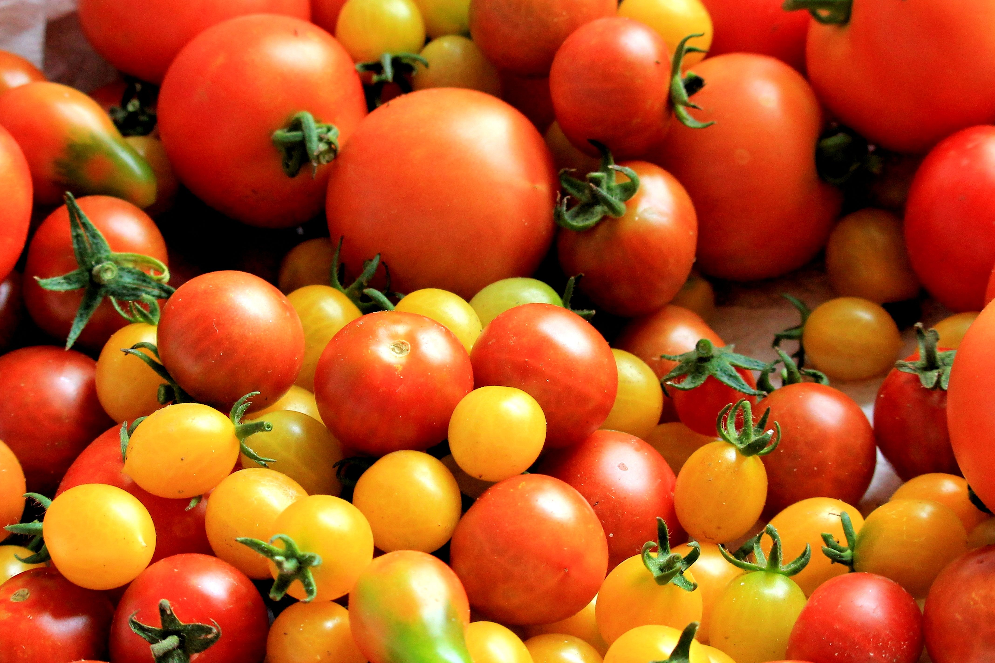
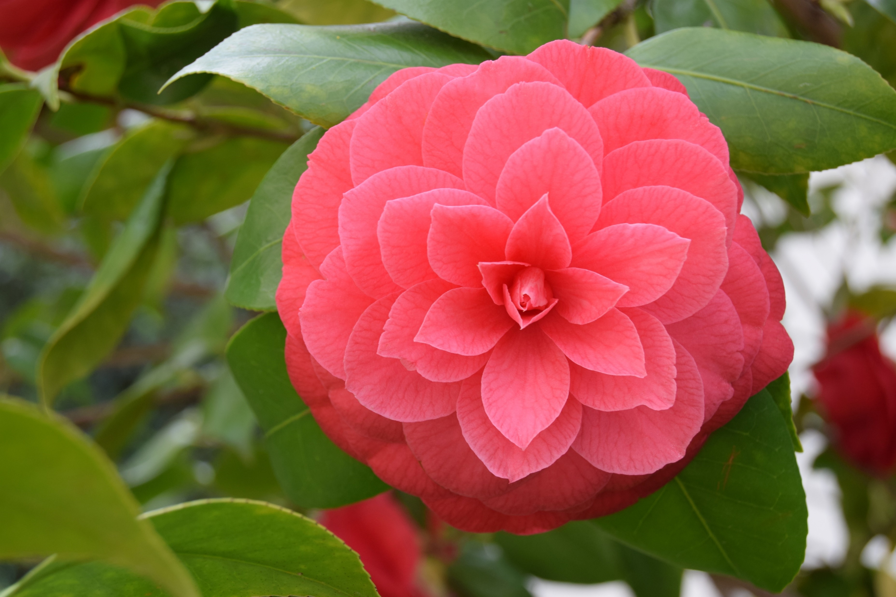
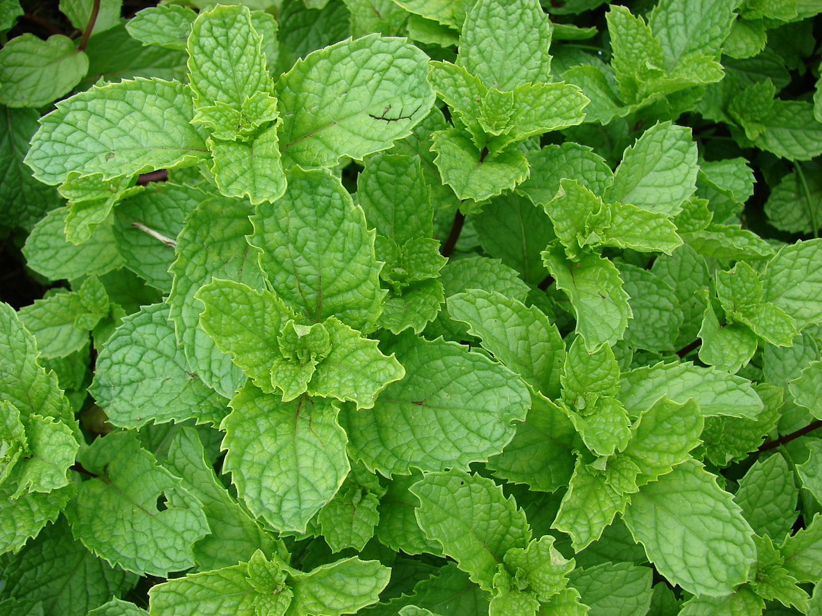
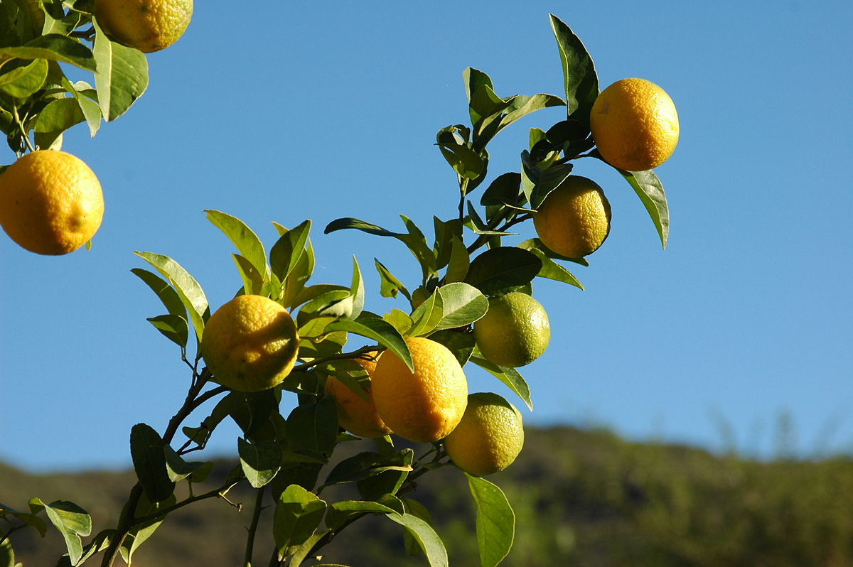
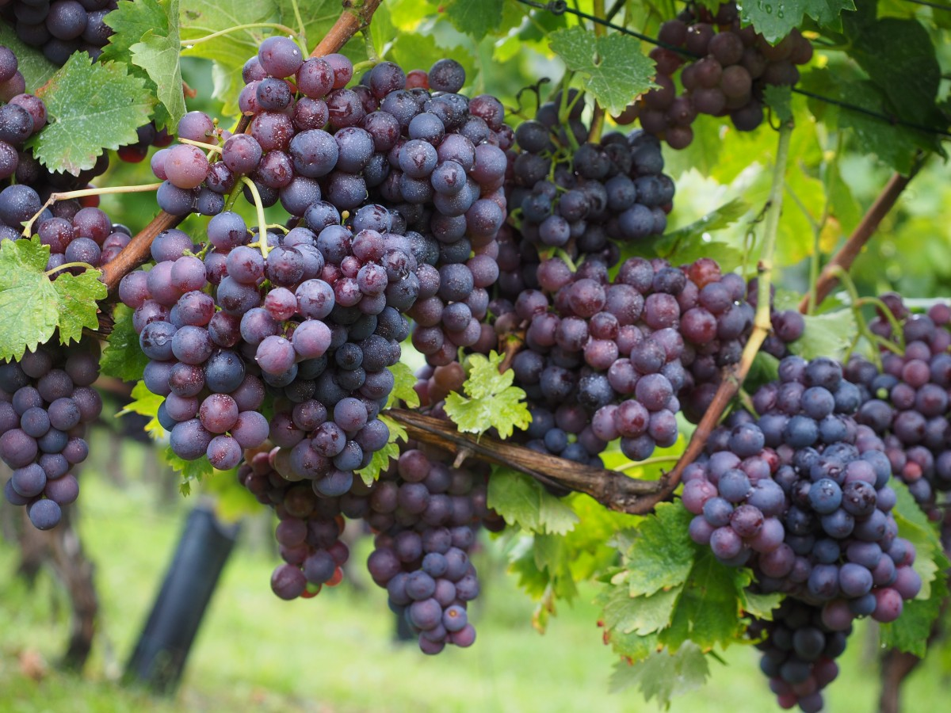
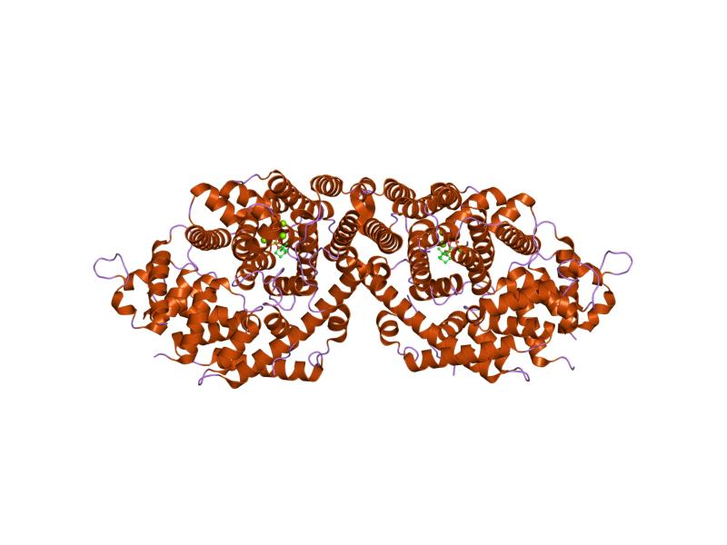

We are interested in TERPENES of …
CORN
TOMATO
CAMELLIA
MINT
LEMON
GRAPES
What are the enzymes involved in the terpene synthesis?
What are its genes?
Deluge of information in scientific literature, thanks to recent advancement!
But…
This Photo by Unknown Author is licensed under CC BY-SA
Notes:
This Photo by Unknown Author is licensed under CC BY-SA
This Photo by Unknown Author is licensed under CC BY-SA
This Photo by Unknown Author is licensed under CC BY
Change the papers image

Slide 32

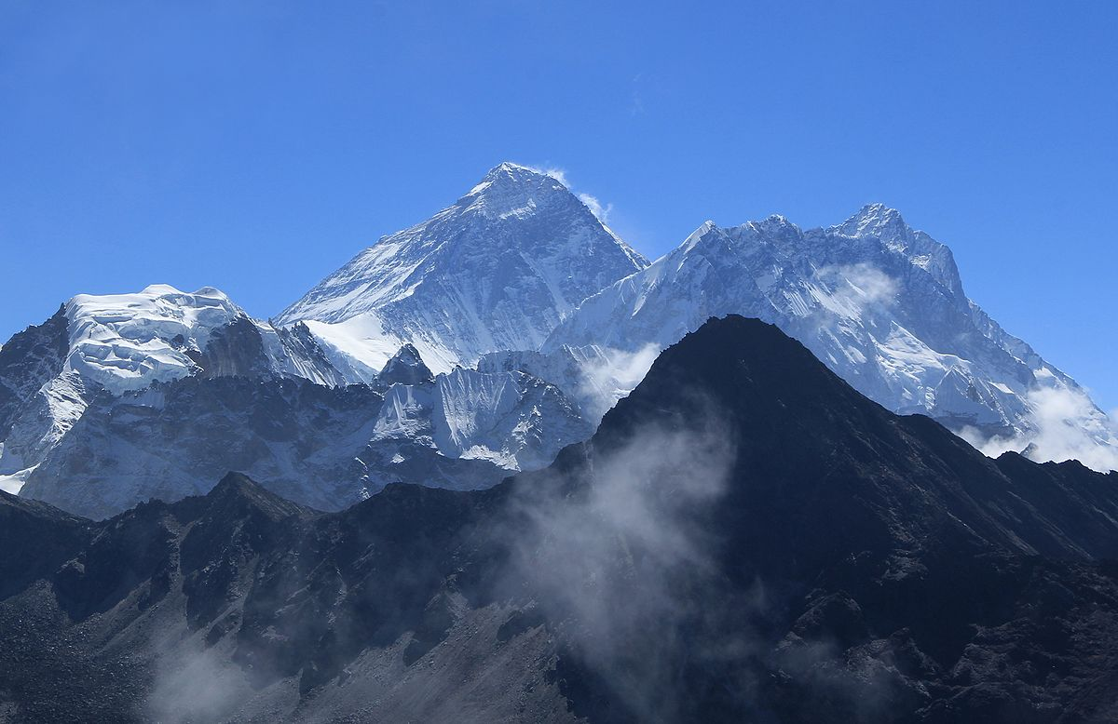
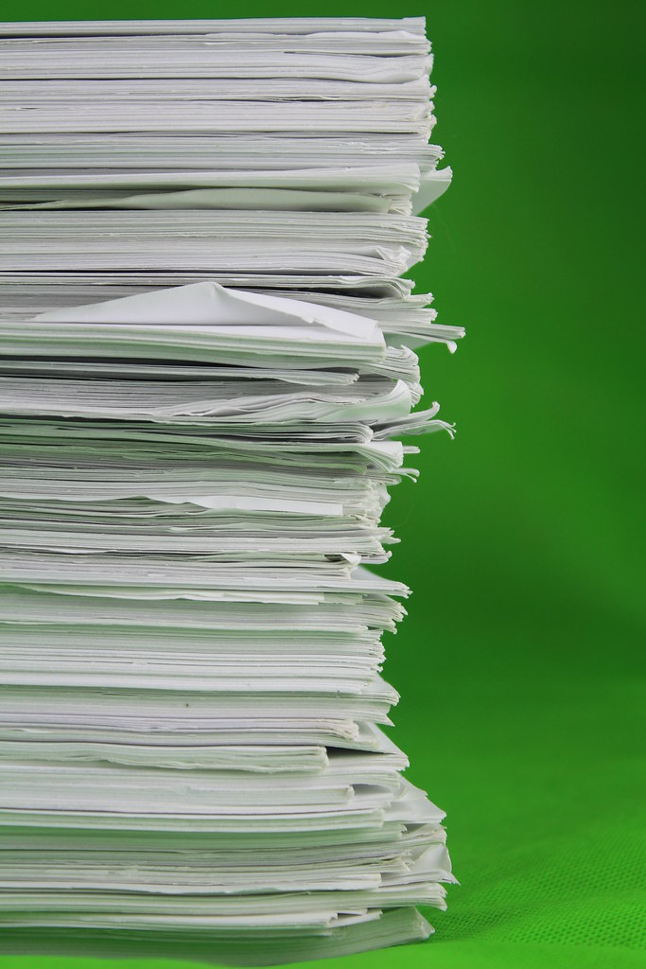
SCIENTIFIC LITERATURE
How big is the scientific literature?
70 Million papers*?!
珠穆朗瑪峰
Mount Qomolangma
Sagarmatha
Mt. Everest
Open
30% Open Access
Scientific literature
closed
Can’t read unless you pay!
One year’s worth of publication in print
*https://blogs.lse.ac.uk/impactofsocialsciences/2020/01/17/not-yet-the-default-setting-in-2020-open-research-remains-a-work-in-progress/
P.S. this is just a back of the envelope calculation! NOT TO SCALE
Notes:
This Photo by Unknown Author is licensed under CC BY
This Photo by Unknown Author is licensed under CC BY-SA
Message in the centre

Slide 33
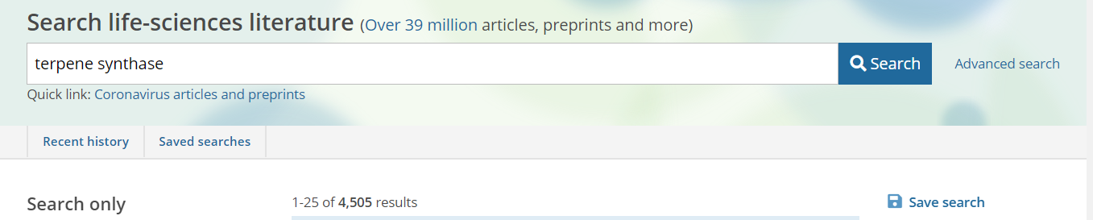

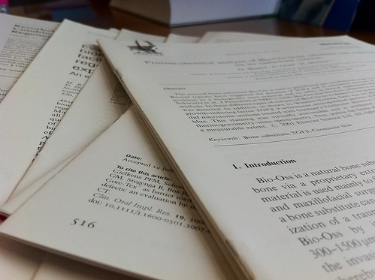
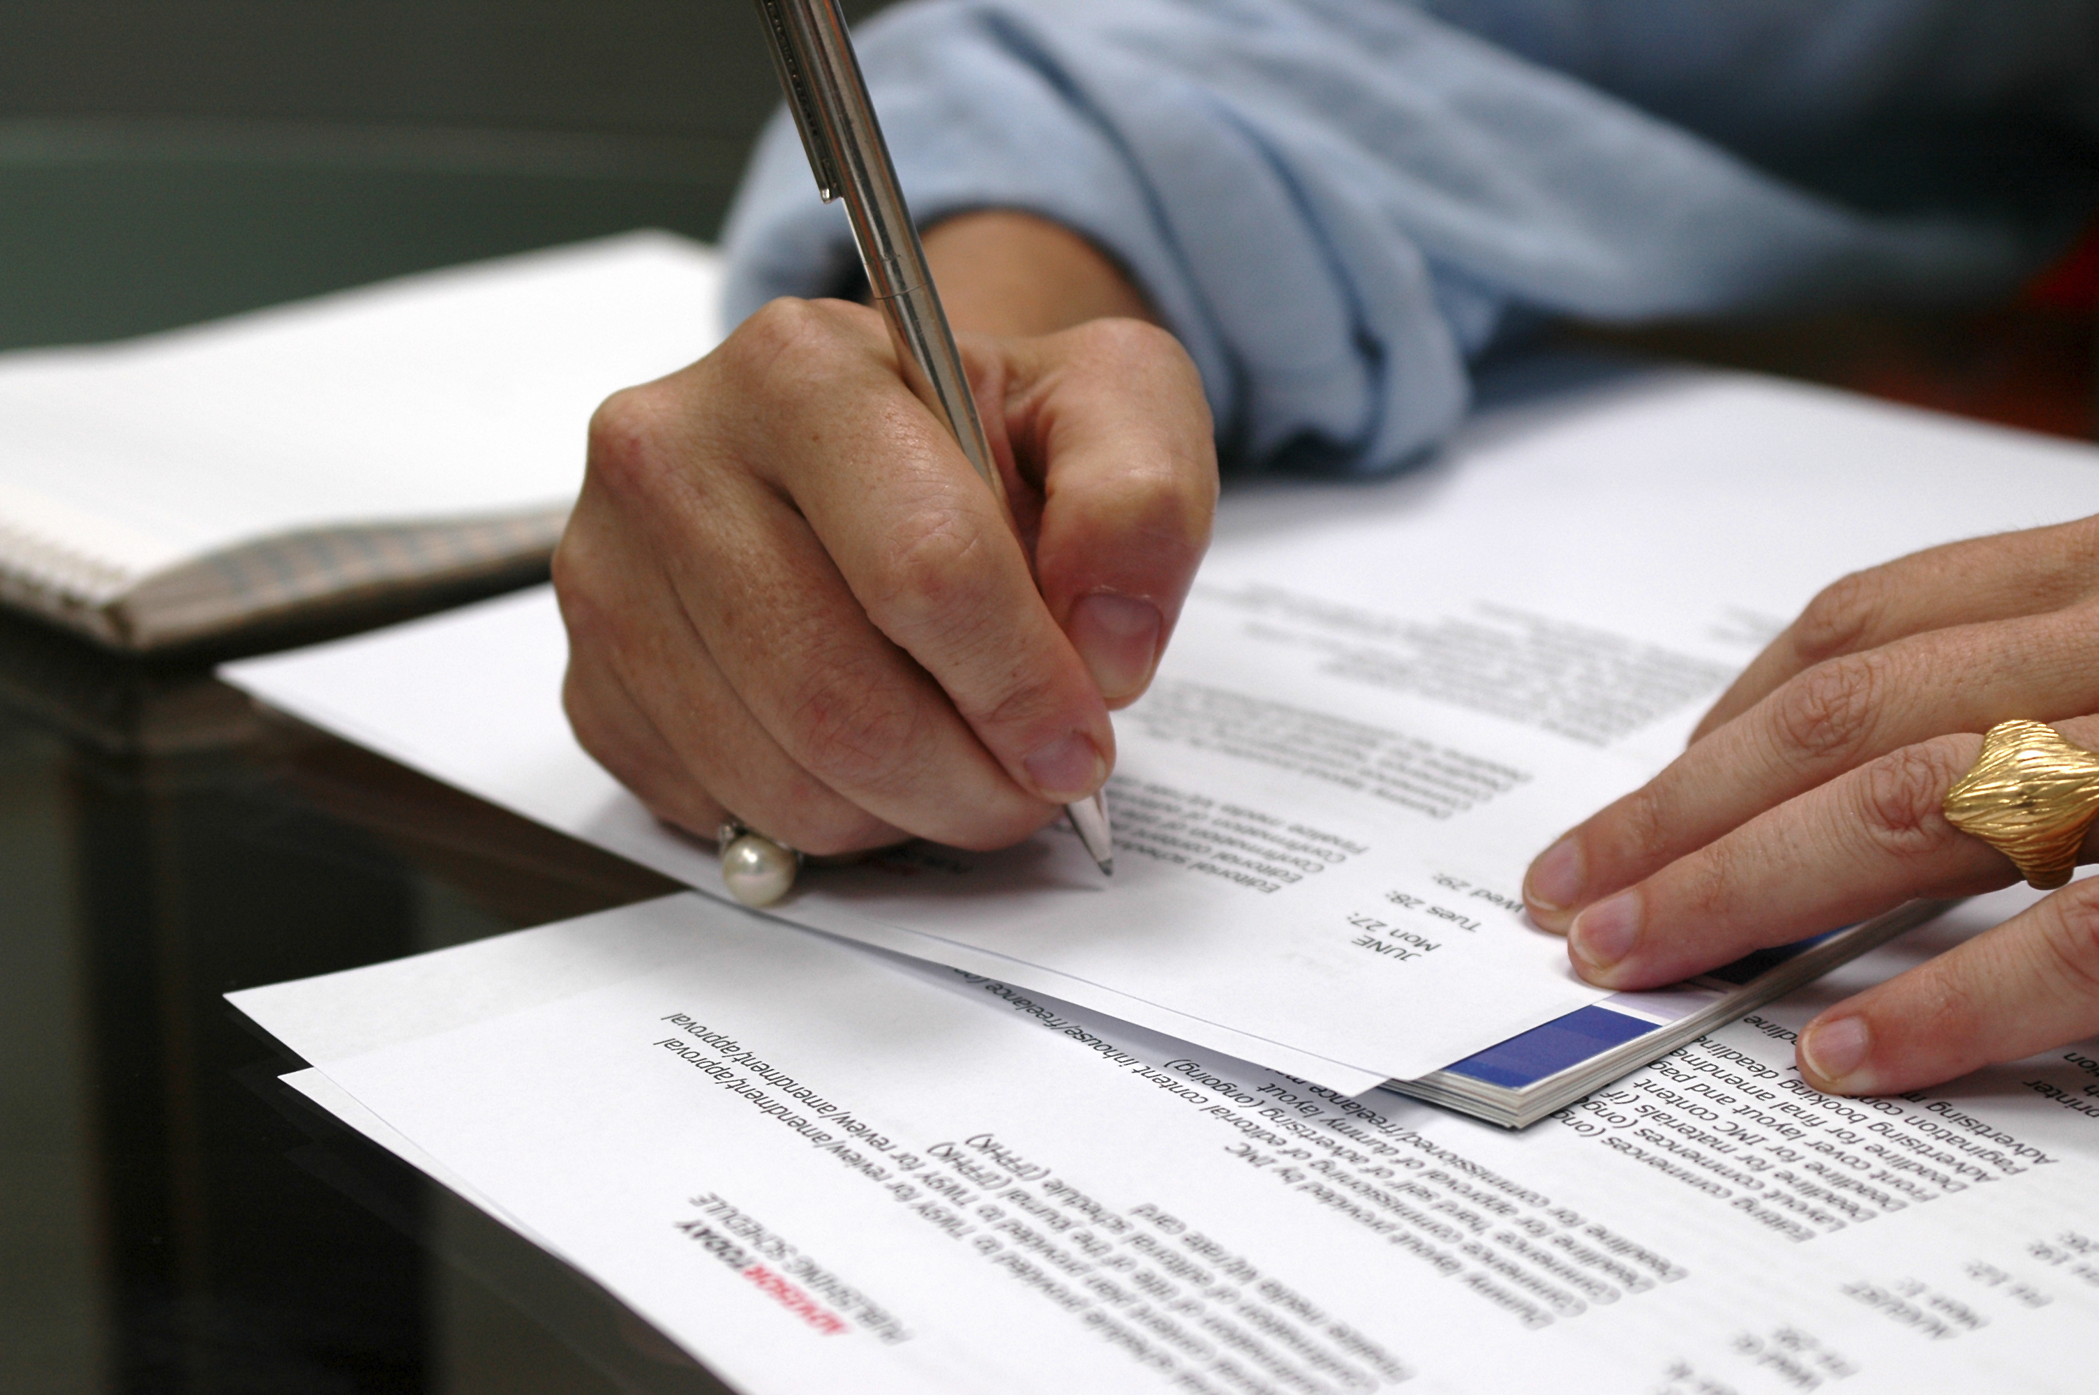



SCOPING THE LITERATURE MANUALLY
I want to read the whole of scientific literature about terpene synthases…
4505 papers
1
Find and Download
2
Read and annotate
3
Comprehend, interpret and infer
Many grad students spend 2 months time on their reviews!
Notes:
This Photo by Unknown Author is licensed under CC BY-SA-NC
This Photo by Unknown Author is licensed under CC BY-SA
This Photo by Unknown Author is licensed under CC BY-SA-NC

Slide 34




SCOPING THE LITERATURE AUTOMATICALLY
CEVOpen Tools can help!
pygetpapers -q "terpene synthase" -n
INFO: Total number of hits for the query are 4505
1
Find and Download
2
Read and annotate
3
Comprehend, interpret and infer
Takes few minutes!
Notes:
This Photo by Unknown Author is licensed under CC BY-SA-NC
This Photo by Unknown Author is licensed under CC BY-SA-NC
This Photo by Unknown Author is licensed under CC BY-SA

Slide 35
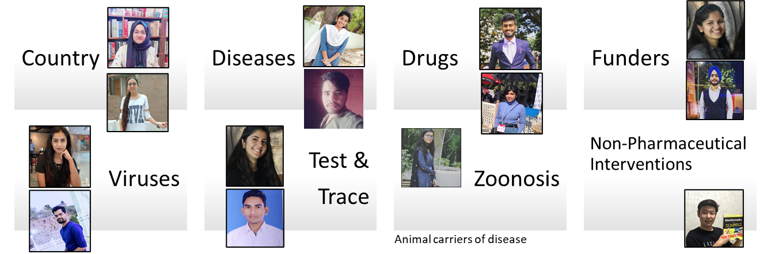


OpenVirus Dictionaries
Multilingual!
Slide Credits: Ambreen Hamadani
Credits: MS PowerPoint 3D Models; Wikipedia (https://en.wikipedia.org)
Notes:
Wikidata and Wikipedia globe
Slide for minicopus
Image of the people involved in each project
Numbers if we do not limit the search
Picture of local machines

Slide 36
Plants Dictionary (CEVOpen)
<entry term="cone“ wikidataURL="http://www.wikidata.org/entity/Q22710" wikidataID="Q22710" wikipediaPage="https://en.wikipedia.org/wiki/Conifer_cone">
<synonym>Cone, Conifer cones, Strobilus, pine cone, pine-cone, pinecone, pine cones</synonym>
<synonym xml:lang="zh">松球</synonym>
<synonym xml:lang="de">Koniferenzapfen</synonym>
<synonym xml:lang="hi">कोणधारी कोण</synonym>
<synonym xml:lang="es">cono</synonym>
<synonym xml:lang="fr">cône</synonym>
<description xml:lang="fr">organe reproducteur des conifères</description>
<description xml:lang="es">estructura vegetal</description>
</entry>
term
Multilingual entries
Credits: Vasant Kumar

Slide 37
Workflow
Download Literature
Search literature using dictionaries
Create Dictionaries
Link to Wikimedia

Slide 38
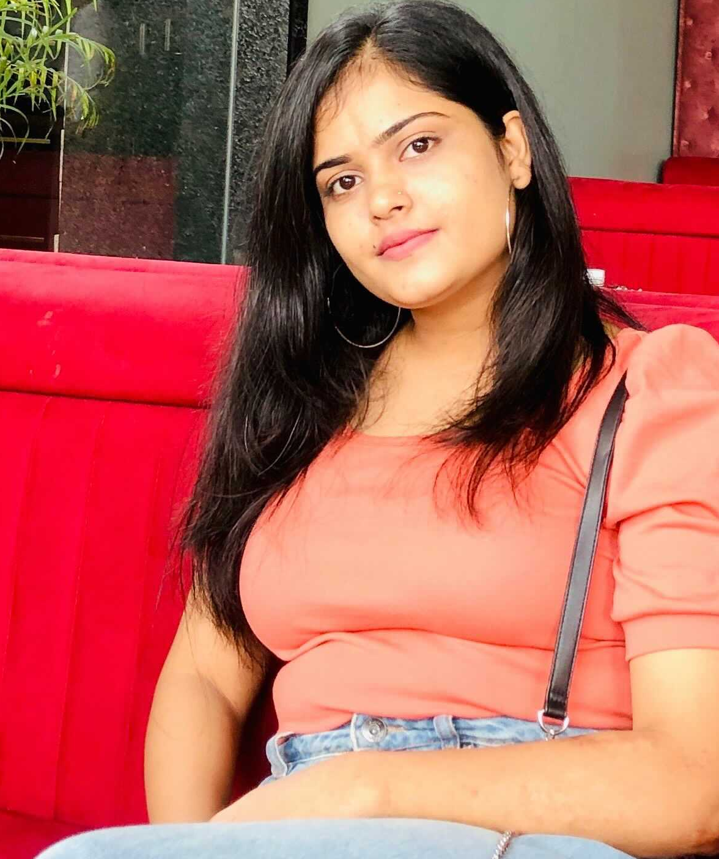

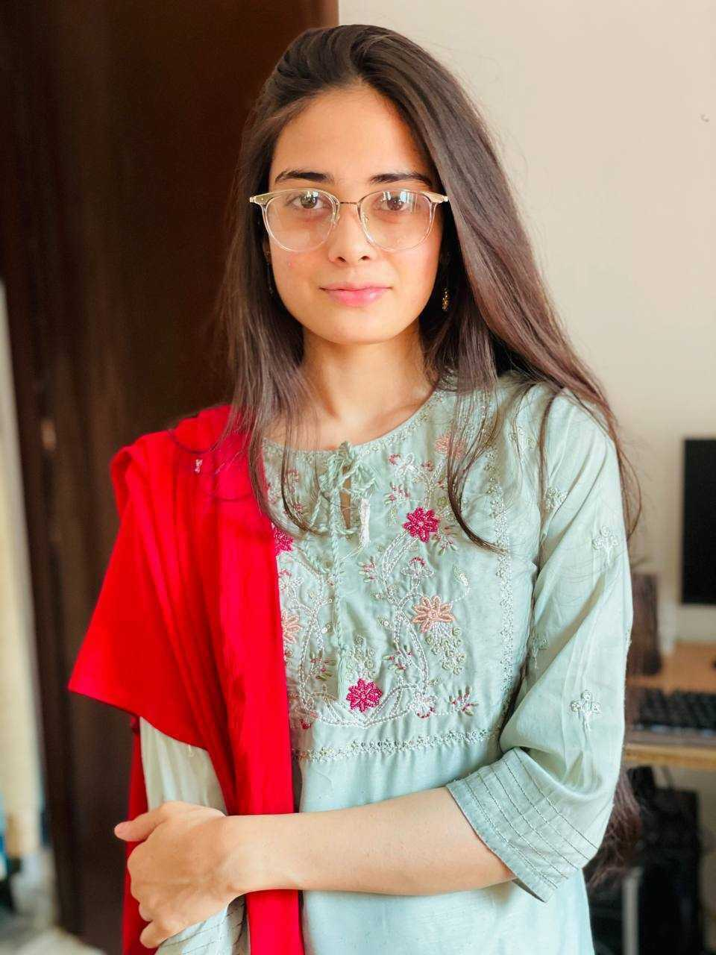

CORN
TOMATO
MINT
GRAPES
CAMELLIA
LEMON
Prachi Singh
Anam Anjum
Anjali Shekhawat
Kumari Rageshwari
Undergrad (Botany), Janki Devi Bajaj Girls Govt. College, Kota
Masters (Botany) Student, Janki Devi Bajaj Government Girls Science College Kota
Masters (Botany) Student,
Jai Narain Vyas University,
Jodhpur, Rajasthan, India.
Masters (Biotech) Student,
Botany Department in University of Rajasthan
Mining Plant Chemistry Literature
KARYA (Knowledge Augmentation through Research in Young Aspirants) Interns
2021 - a sustainable future for Wikidata
https://en.wikipedia.org/wiki/Terpene_synthase_N_terminal_domain , CC BY-SA
Notes:
This Photo by Unknown Author is licensed under CC BY-SA

Slide 39

Next up: Prachi Singh
2021 - a sustainable future for Wikidata

Slide 40
Creating Dictionaries from Wikidata SPARQL
Our Mining tool created from Wikidata!
Prachi Singh
KARYA Intern
CORN मक्का
2021 - a sustainable future for Wikidata

Slide 41

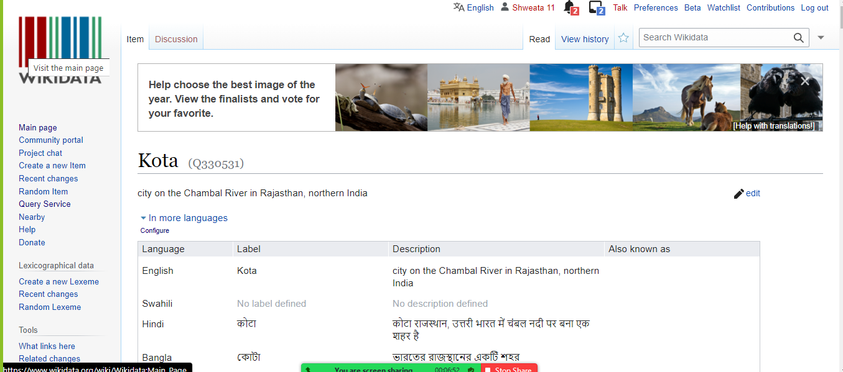
About Me - Prachi Singh (प्राची सिंह)
From: Kota (Q330531), Rajasthan
Bachelors (Botany) from Janki Devi Bajaj Girls Government College, Rajasthan, India.
Joined CEVOpen in Sep. 2021
Working hard to learn – open source tools and open science
2021 - a sustainable future for Wikidata

Slide 42

Workflow
Download Literature
Search literature using dictionaries
Create Dictionaries
Create Dictionaries
SPARQL method
Link to Wikimedia
Notes:
This Photo by Unknown Author is licensed under CC BY-SA

Slide 43


Dictionary creation using Wikidata
ami dict
Dictionary
2021 - a sustainable future for Wikidata
This Photo by Unknown Author is licensed under CC BY-SA

Slide 44
SPARQL Query
https://w.wiki/4HEb
#diterpenes
SELECT ?item ?itemLabel
WHERE
{
?item wdt:P31 wd:Q59447. # instance of diterpene
SERVICE wikibase:label { bd:serviceParam wikibase:language "[AUTO_LANGUAGE],en". } # Helps get the label in your language, if not, then en language
}
2021 - a sustainable future for Wikidata

Slide 45
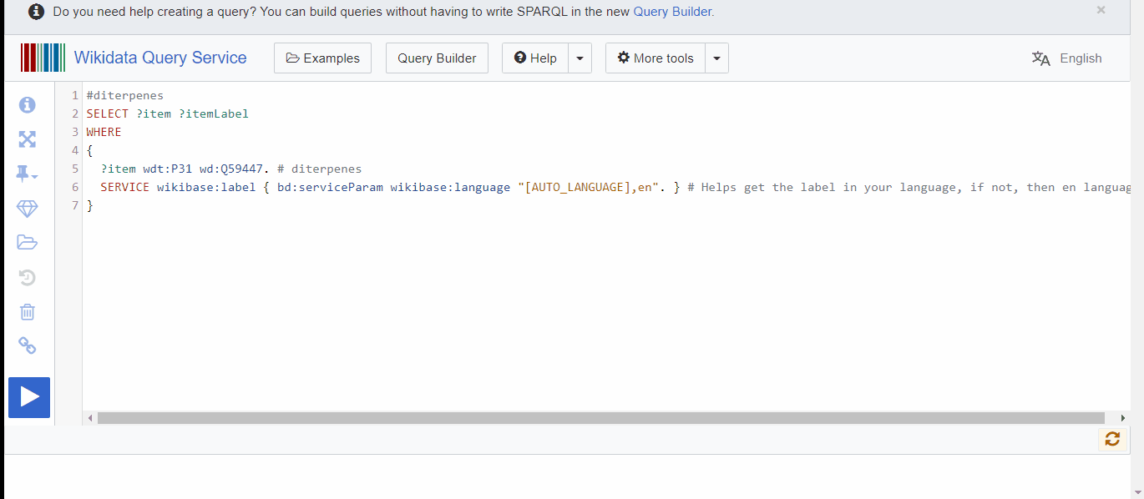
SPARQL Demo
2021 - a sustainable future for Wikidata

Slide 46
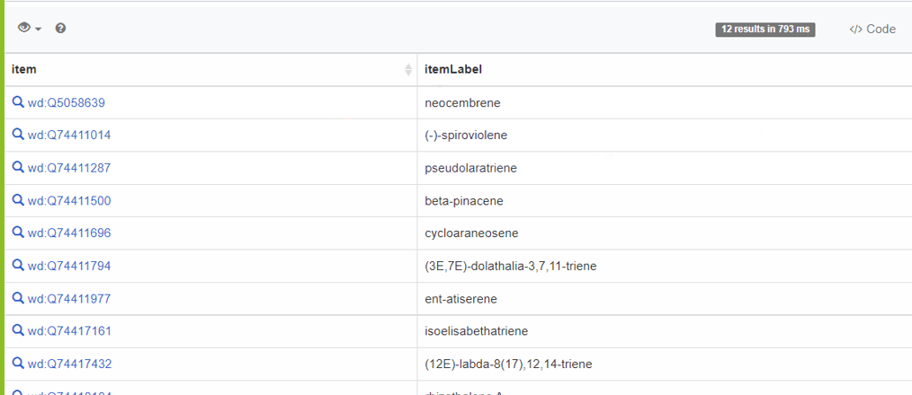
SPARQL Results

Slide 47
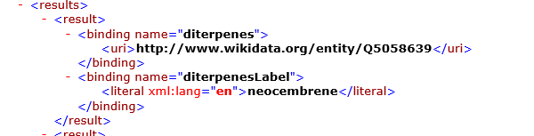
SPARQL Endpoint (XML)
Wikidata ID
These go into the dictionary…
2021 - a sustainable future for Wikidata

Slide 48
One last step:`ami-dict` to convert into dictionary
>amidict -vv
--dictionary diterpenes
--directory ami_terpene_dict
--input diterpene_sparql_out.xml
create --informat wikisparqlxml
--sparqlmap # map SPARQL output to AMIDict
wikidataURL=diterpenes,
term=diterpenesLabel,
--transformName wikidataID=EXTRACT(wikidataURL,.*/(.*))
2021 - a sustainable future for Wikidata

Slide 49
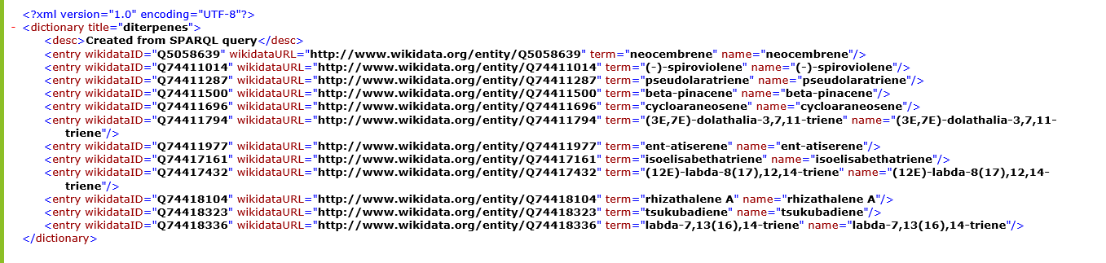
Final Dictionary!
Wikidata ID
Term
Ready to go off and annotate the scientific literature!
2021 - a sustainable future for Wikidata

Slide 50
Communal ontologies

Slide 51
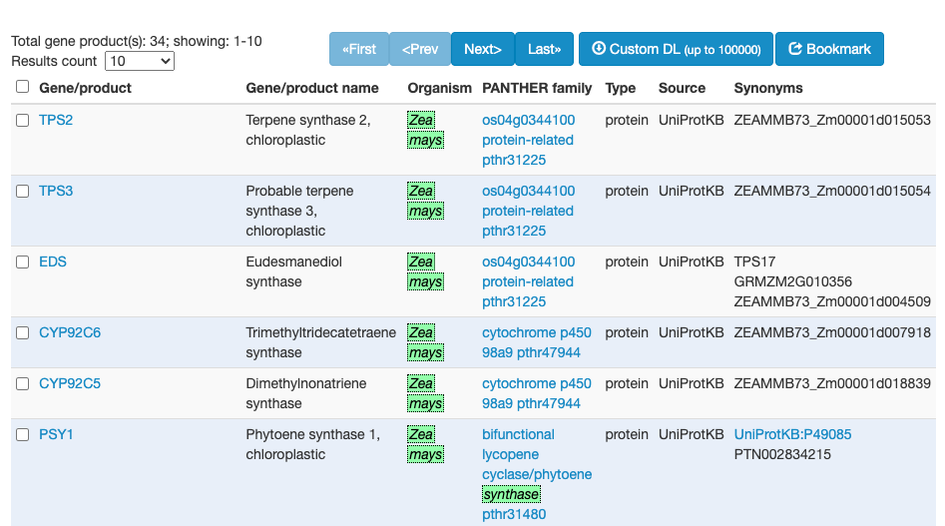
Gene Ontology (GO) and browser links Species, Genes and Proteins
Gene Product
Proteins
Maize

Slide 52
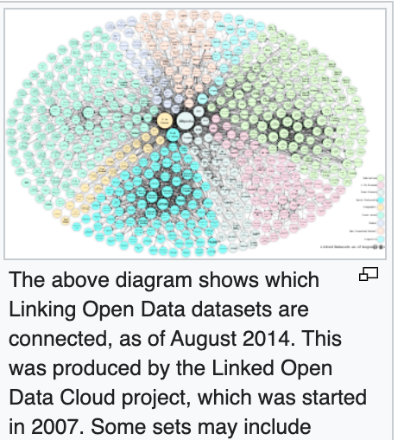

https://en.wikipedia.org/wiki/Linked_data

Slide 53

DBPedia 2007
Collection of
links in Wikipedia
DBpedia
Drugbank
UniProt
PDB
Gene
Ontolopgy
PubChem
ChEMBL

Slide 54
Linked OpenData cloud

Slide 55
Wikidata
Linked OpenData
100 million items
Dictionaries
Documents

Slide 56



Slide 57



Slide 58
Search, annotation, mining

Slide 59

abstract
Captioned
Figures
methods
Fig. 1
MINING
with sections
and dictionaries
HTML tables
references
abstract
Captioned
Figures
Dict A
Fig. 1
Image
Caption
methods
HTML tables
Dict B
references
Table
Caption
[W3C Annotation / https://hypothes.is/ ]

Slide 60
We make a simple dictionary for materials
<dictionary title="materials">
<entry term="anode" wikipedia="anode" wikidata="Q181232" description="electrode through which conventional current flows into a polarized electrical device"/>
<entry term="cathode" wikidata="Q175233" description="electrode from which …"/>
<entry term="current density" wikidata="Q77680811”/> …

Slide 61
Annotation using Dictionaries
file="liion/PMC4062906/methods/search/elements/results.xml">
<result pre="foil and dried at 80°C under vacuum for 5 h." exact="Lithium" post="sheet was served as counter and reference …"/>
methods = section
PMC4062906 = reference
elements = dictionary
(annotation to W3C spec)

Slide 62


Cascading dictionaries

Slide 63


Dashboard of 200 articles searched with 5 dictionaries
biblio
country
element
funder
magnetism
battery

Slide 64



Downstream Computation:
Co-occurrence of words

Slide 65
Thanks:
NIPGR, Delhi for 11 interns
INYAS 5 interns
KARYA 4 interns
Wikimedia grant to ContentMine
https://github.com/petermr/openVirus viral epidemics
https://github.com/petermr/CEVOpen plant science
https://github.com/petermr/ami3 AMI Semantic framework
https://github.com/petermr/pyami Python AMI Semantic framework
https://github.com/petermr/pyamiimage Python Image mining
https://slideshare.com/petermurrayrust. Many talks

